Slide 1

Portuguese Bank
Braden Heuglin

Slide 2
Why I Chose this Dataset
Finance Major
Enjoy working with money

Slide 3
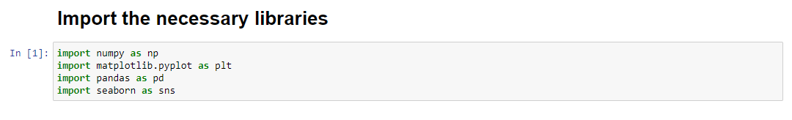
Importing the Tools

Slide 4
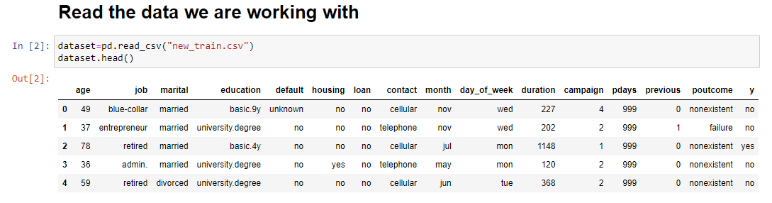
Reading the Data

Slide 5
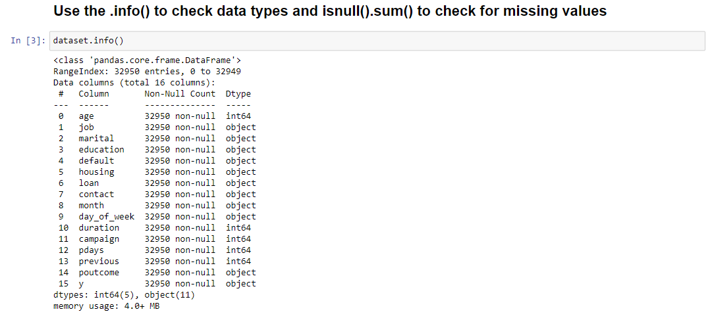
Using .Info()

Slide 6
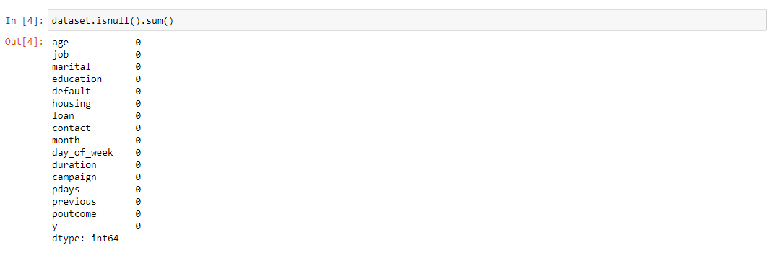
Check for Missing Values

Slide 7
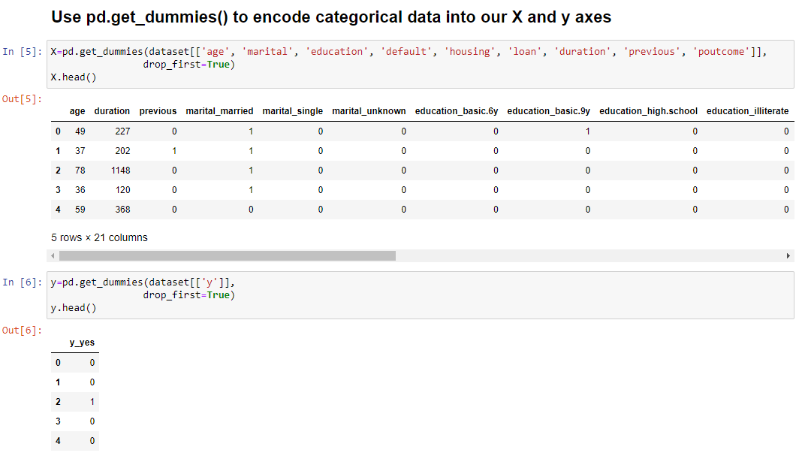
Using pd.get_dummies()

Slide 8
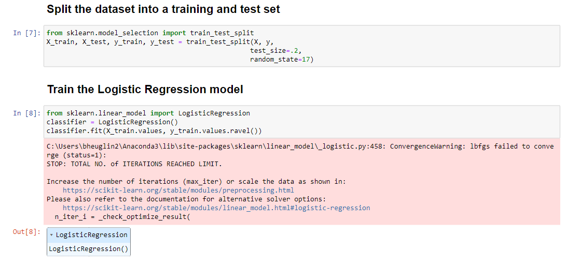
Training and Test Sets

Slide 9
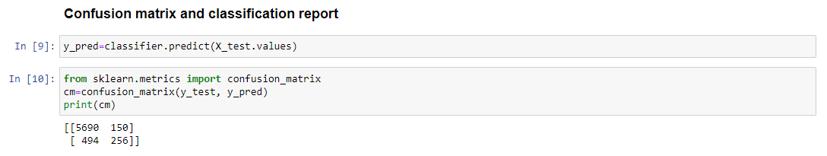
Confusion Matrix Setup

Slide 10
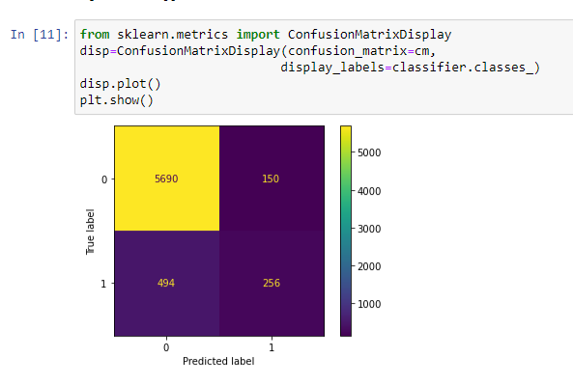
Confusion Matrix Results
Random State: 17
Test Size: 20%
True Negative: 5690
True Positive: 256
False Positive: 150
False Negative: 494
Accuracy Score: 90.23%

Slide 11
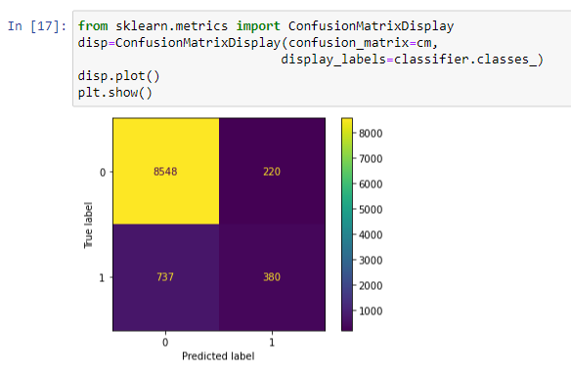
Other Outcomes
Random State: 17
Test Size: 30%
True Negative: 8548
True Positive: 380
False Positive: 220
False Negative: 737
Accuracy Score: 90.32%

Slide 12
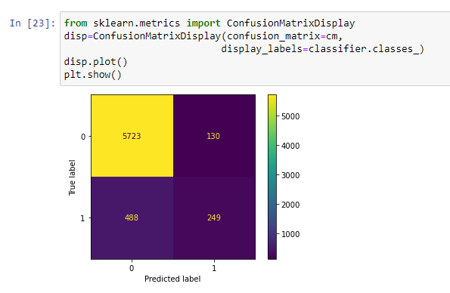
Other Outcomes
Random State: 23
Test Size: 20%
True Negative: 5723
True Positive: 249
False Positive: 130
False Negative: 488
Accuracy Score: 90.62%

Slide 13
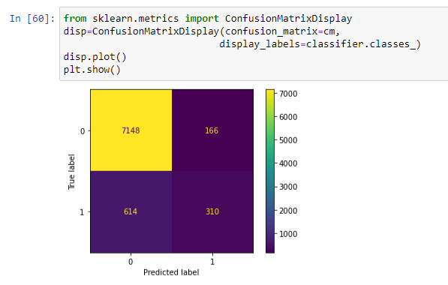
Other Outcomes
Random State: 23
Test Size: 25%
True Negative: 7158
True Positive: 310
False Positive: 166
False Negative: 614
Accuracy Score: 90.53%

Slide 14
Conclusion
Import tools required
Read and clean the data if necessary
Encode categorical variables
Split into training and test sets
Create confusion matrix using predicted values vs. actual values

